Slide 1
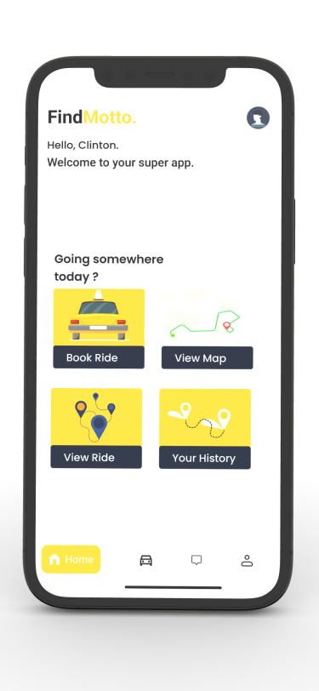
PASSENGER POSITIONING SYSTEM
UI DESIGN AND IMPLEMENTATION

Slide 2
Table of contents
01
02
03
Introduction
Tools
Definition of UI
Refers to what was used during the design phase
Designs
Overall design of the system

Slide 3
INTRODUCTION
User Interface (UI) refers to any method or means by which the end-user of a product interacts with or controls a product, software or hardware device. This includes screens, keyboards or a mouse.

Slide 4
TOOLS USED
Figma
Andriod studio
Visual studio
Visual Studio code

Slide 5
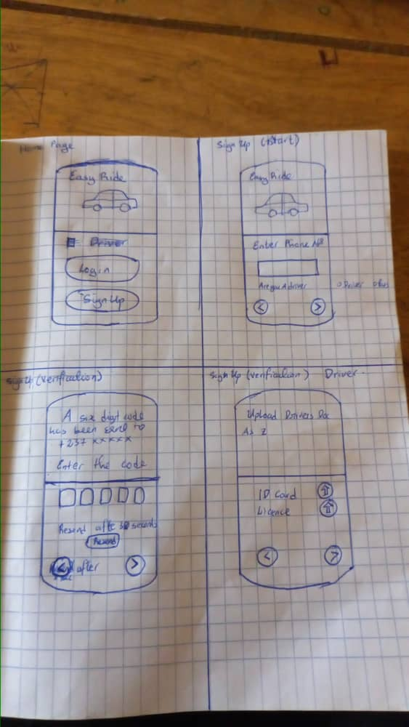
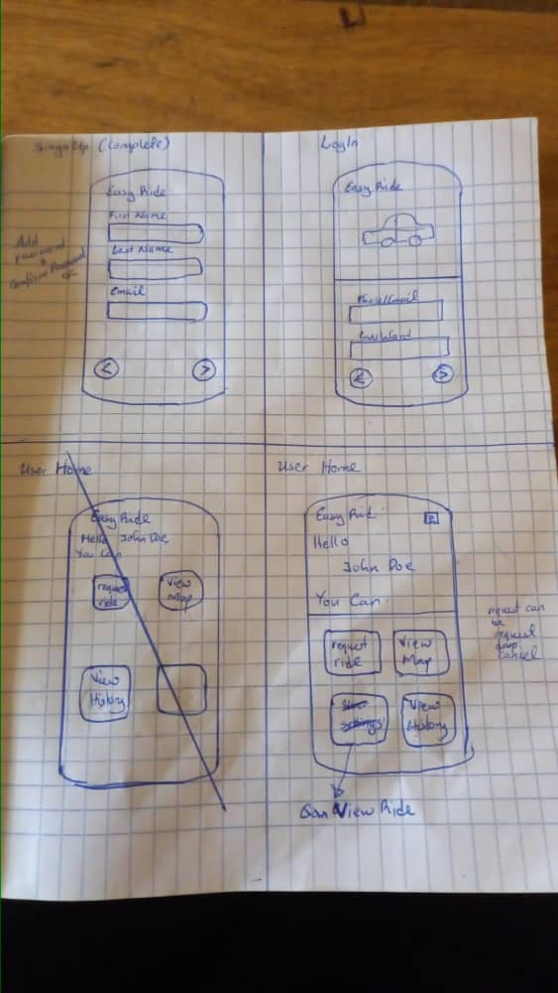
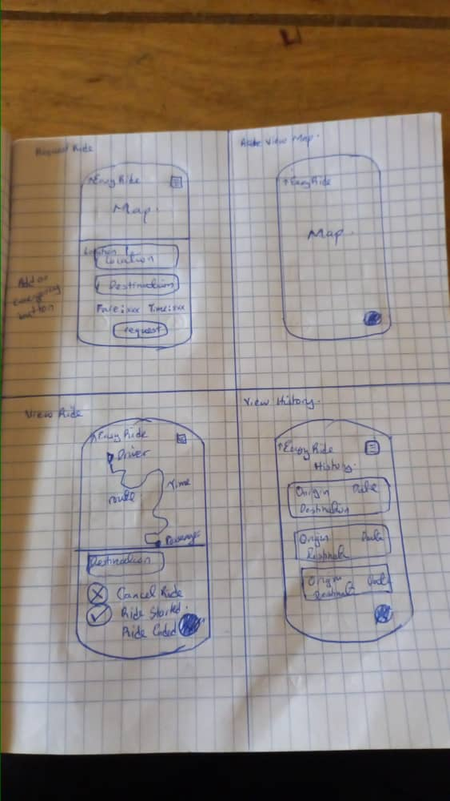
Design Process
Design Research
Sketching
User Persona
Design System of Competitors
Software Tools

Slide 6
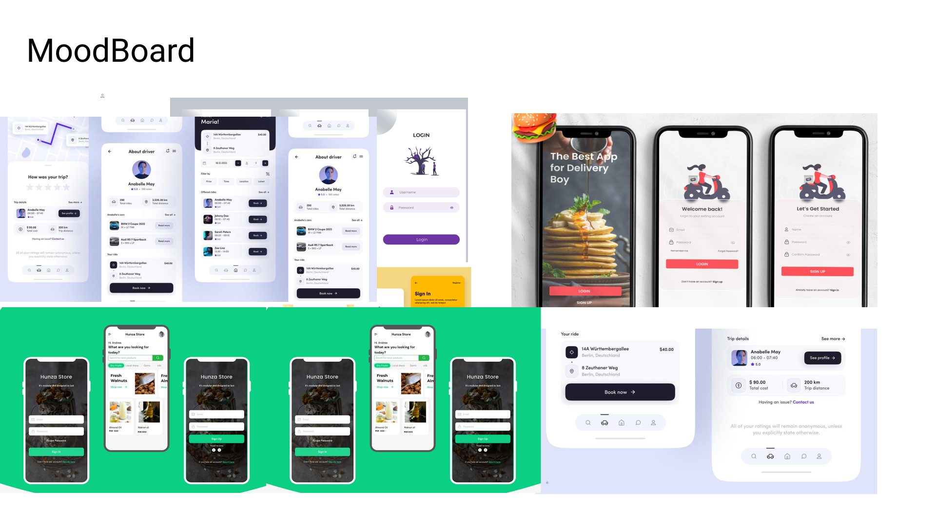

Design Process
Moodboard
Design System
ccccccc

Slide 7
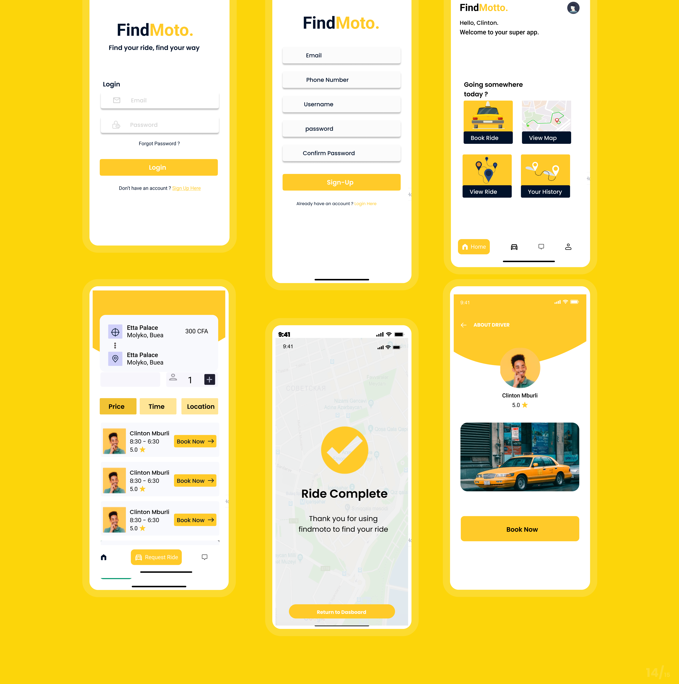
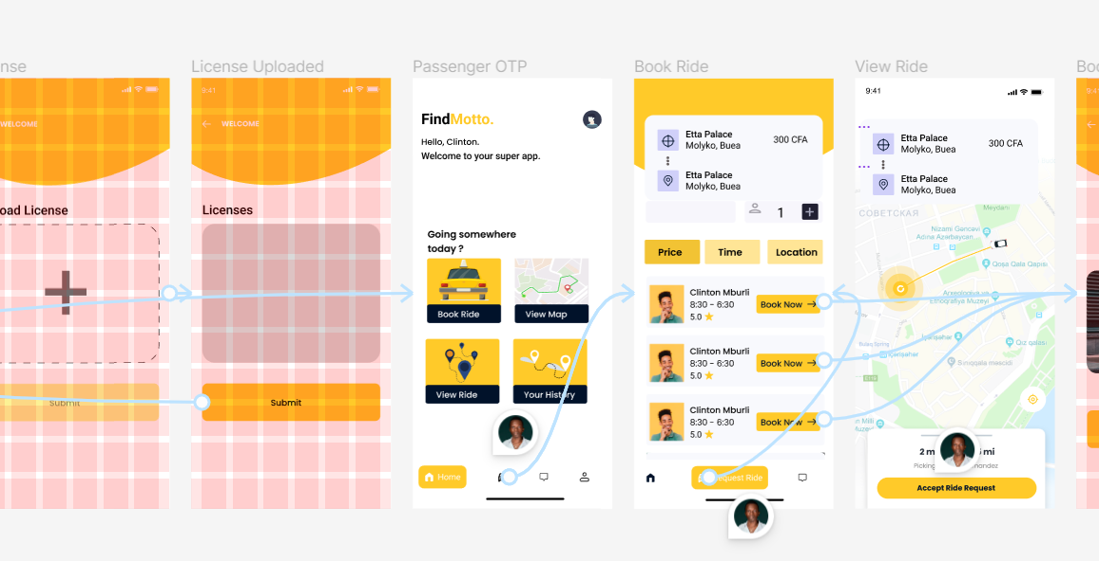
User Interface Design
User Interface
Prototype

Slide 8
GETTING STARTED WITH FINDMOTO
Splash screen
Log In / sign up
Users choose one
User gets welcomed to the app
Get started
Sign up
You are asked to choose if you are a driver or a passenger
Presents a page requesting your information

Slide 9
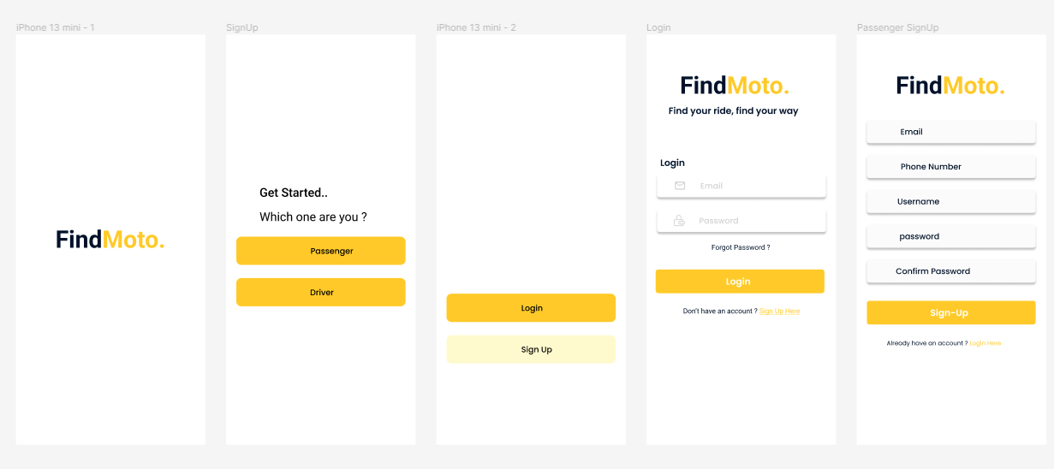
GETTING STARTED WITH FINDMOTO

Slide 10
AUTHENTICATING USERS / DRIVERS
01
02
03
OTP code
Driver authentication
Login
Users are sent a code. That they have to input to complete their registration.
Drivers get to update their license, ID card, and car image
After all authentication, you can now login and get started

Slide 11
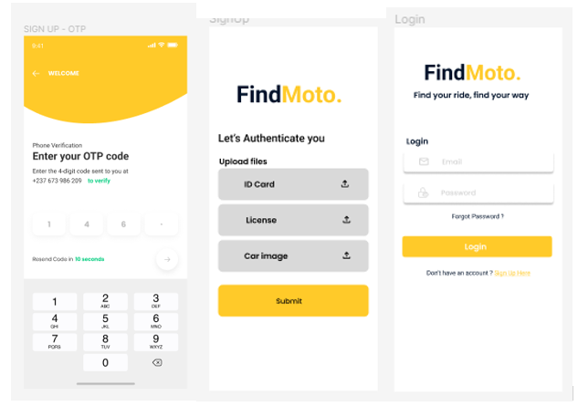
AUTHENTICATING USERS / DRIVERS

Slide 12
PASSENGER SPECIFIC PAGES
PASSENGER HOME PAGE
RIDE COMPLETE
Links to other screens are displayed here
This screen is displayed if driver accepts a ride or not
BOOK RIDE
HISTORY
System does driver-passenger matching and suggests it to passenger
Passenger can view their previous locations here

Slide 13
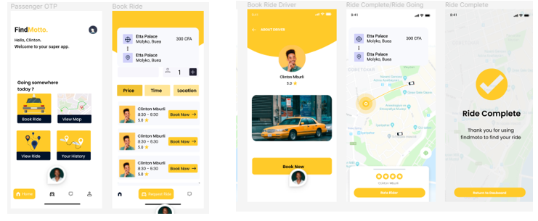
PASSENGER SPECIFIC PAGES

Slide 14
DRIVER SPECIFIC PAGES
Driver dashboard
View map
the driver is presented with the various screens he has access to
He views the passenger/ driver congestion
View ride request
History
Views and is able accept ride request from various users
Drivers can view their previous locations here

Slide 15
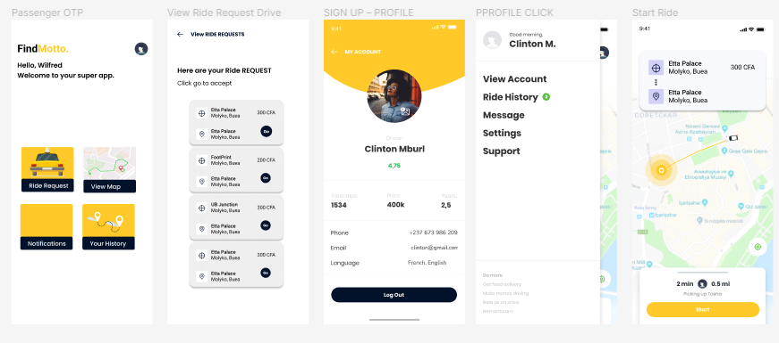
DRIVER SPECIFIC PAGES

Slide 16
THANK YOU

